Slide 1
Phase 1

Slide 2
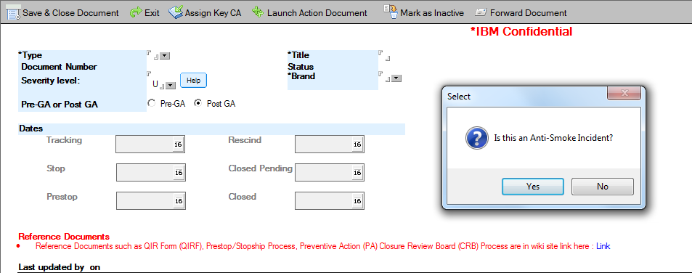
Single value change name to Primary Affected Brand, add a second field that is additional brands affected
See next pages for rules

Slide 3
severity field rules
1) The default value for the severity should be "U" if no selection is made
2) Add a new value "P" to be used to indicate that the severity level is pending an evaluation.
3) If "P" is selected, then open a text field called Pending Description (200 characters, text only). This field is mandatory if P is selected.
Change the Severity setting to follow the following logic
If the form is set to STOP SHIP, then force the severity level to 1 and make the field non-editable
If the form is set to Prestop, the Severity field is editable. If the value selected is 1, 2 or 3, set Field Impact to Y and Field Impact Severity to the same number as Severity. If Field Impact severity is set to 1, 2 or 3, then set the severity level to the same number. Both fields need to be in sync if either is set to 1, 2 or 3.
If PA is launched, check severity. If severity is set to P or U, then do not allow PA document to be launched. Provide message that PA cannot be launched if Severity is P or U.
If main form is being closed, check Severity level – do not close if severity is P or U. Provide message that PA cannot be closed if Severity is set to P or U.
Severity | Field Impact | Field Impact Severity
1 | Y | 1
2 | Y | 2
3 | Y | 3
4 | N
5 | N
0 | N
P | N
U | N

Slide 4
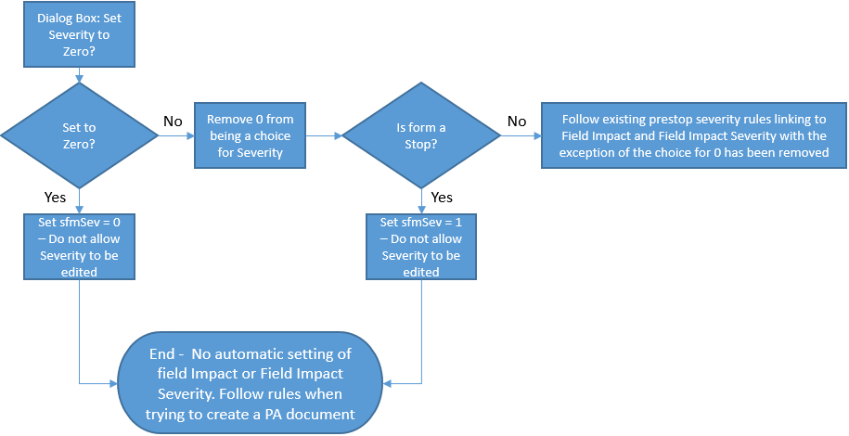
When a New Document is created, have a pop up window with the Message: “Is this an anti-smoke incident?” with a Yes/No Choice.
If No, then close the dialog box, do not allow 0 to be chosen as a severity and continue with the current logic from CR 76.
If yes, do the following
If this is a Stop form, set the severity to Zero and do not allow it to be edited. Make sure the logic between Field Severity and Severity to be decoupled. This means the logic that forces all Stops to Severity 1 needs to be changed. If Servity zero chosen, set Severity to Zero. Otherwise set Severity to 1.
If Prestop or tracking, force severity to zero, make the severity non-editable and decouple the logic between Severity or Field Severity.

Slide 5
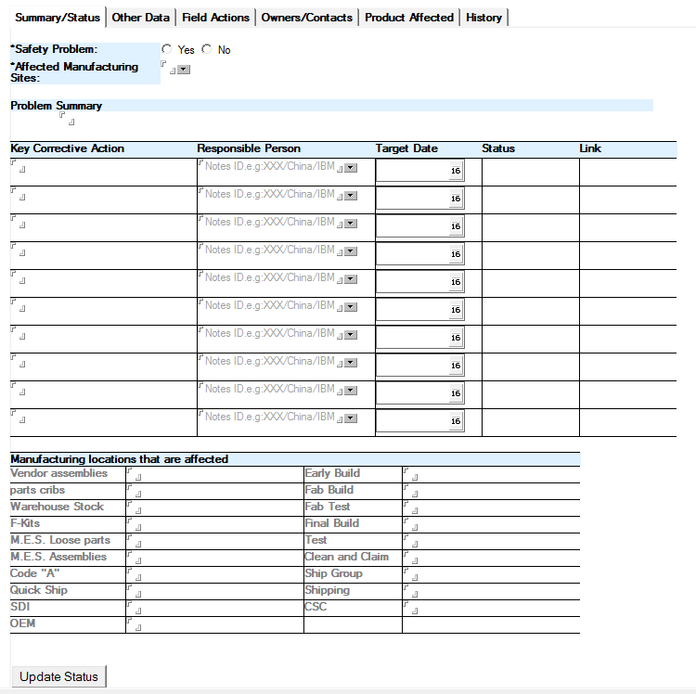
Convert to action tracker
Not Required

Slide 6
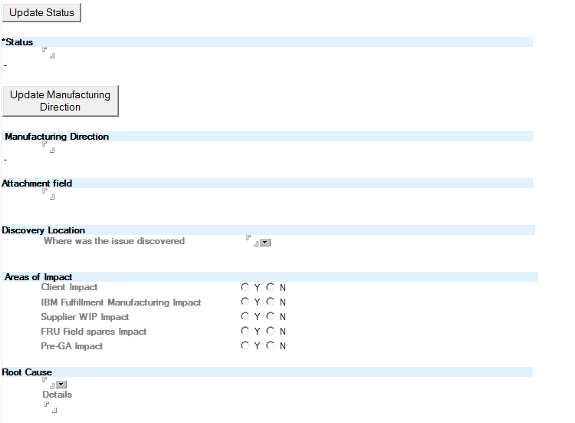
New Function, Capture meeting minutes, including date and store it in table. In form, display the latest minutes, option to view other meeting minutes. Button to push latest meeting minutes to team members
Move to Mfg Impact page
Not Required on Stop form – only CRB

Slide 7
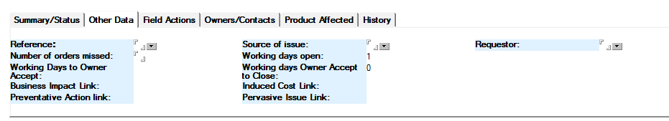
Not Required

Slide 8
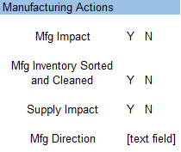

Slide 9
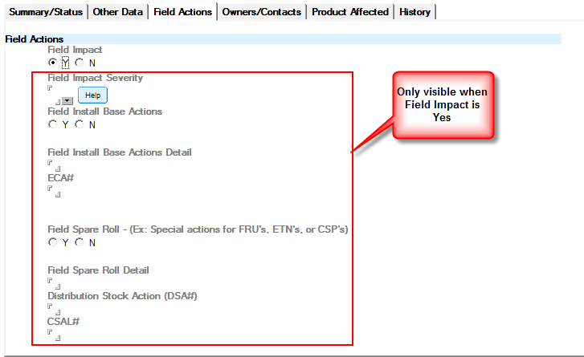

Slide 10
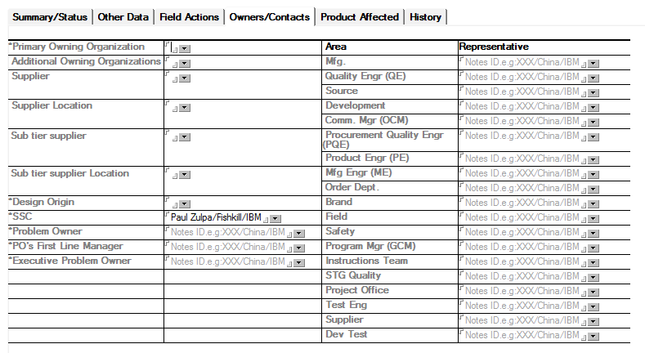
Make Mandatory w NA option. New Supplier function
New Supplier Loc function
Issue Owner
Issue Owner Mgr
Executive Issue Owner
System Assurance
Input 1 row at a time
Input Area | Input Representative | Add Additional member

Slide 11
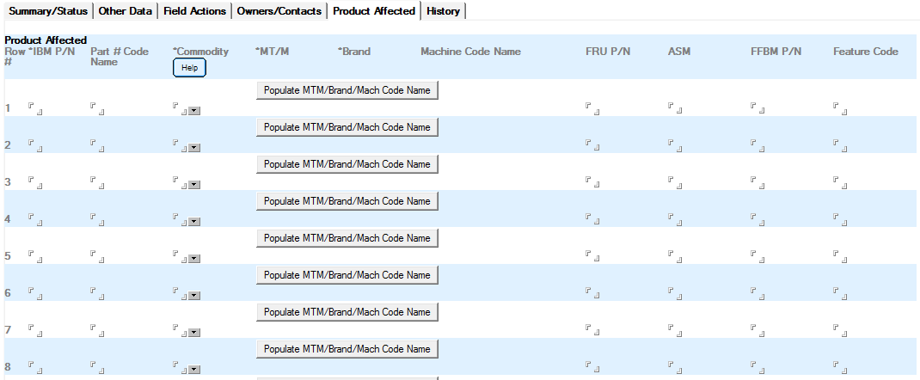
Needs Invention

Slide 12
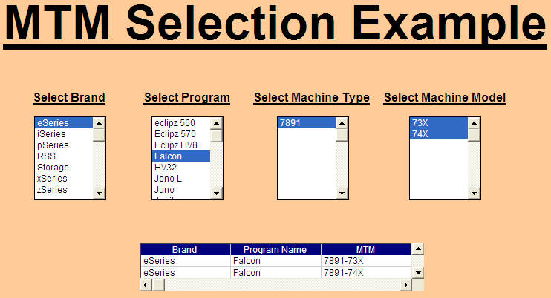
Combine MT and Model into one
No Brand – you already selected brand at the beginning
If you pick programs, filter MTM
Allow multi selection – right click, select all

Slide 13
PN Selection
PN Selection not tied to MTM
Input PN – look up key info on PN (description, commodity, etc)
PNs need to be individual – not concatenated
Need dummy PNs
Mandatory field
When the issue being worked as a stop or prestop is a FW issue, the team has to dummy up the “IBM P/N” field since there is no IBM P/N associated with the FW. Is there a way we can create a character string, representing FW, that would be accepted in the “IBM P/N” field such that dummy P/N’s would not have to be entered. As an example “IBMCODE”. Needs to cover “Software” or Firmware” “BOM Error” and “Certification” and other non-IBM PN issue

Slide 14
PA Form

Slide 15
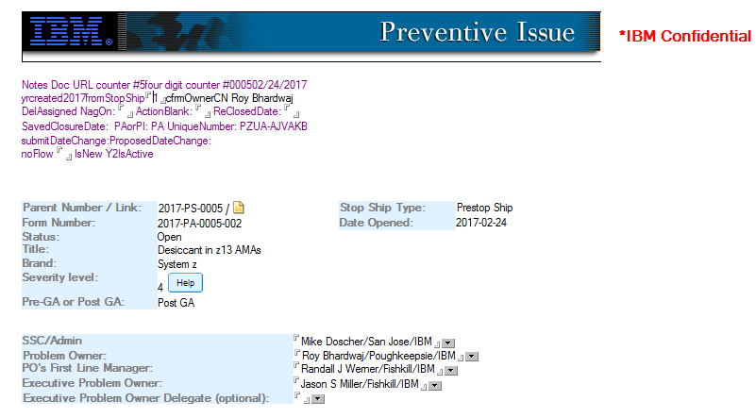
When starting CRB, ask if Problem Owner same as issue owner. If same, copy over, if not, user needs to input
Not Required (Same as main form)
Need Acceptance Process

Slide 16
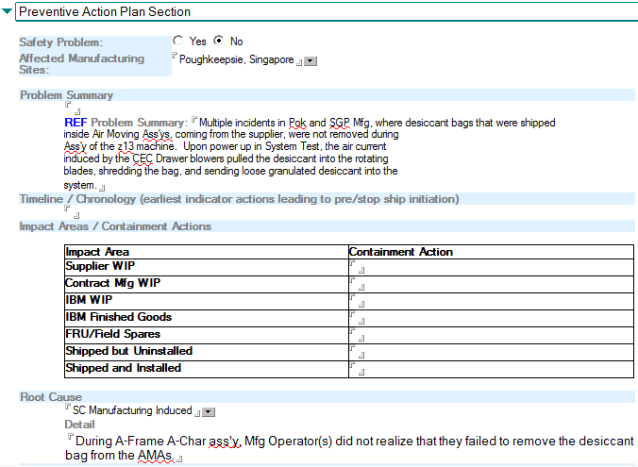
Not Required (Same as main form)

Slide 17
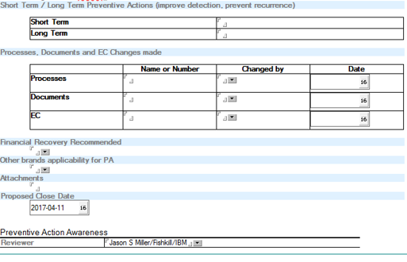
CRB Action Tracker
Not Required

Slide 18
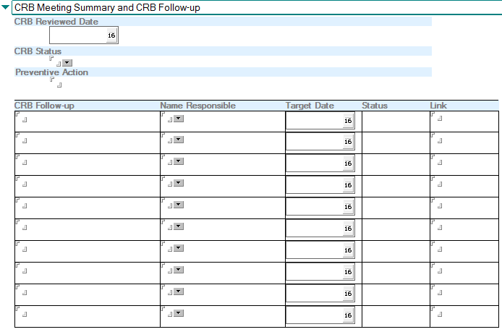
CRB Summary
CRB Action Tracker

Slide 19
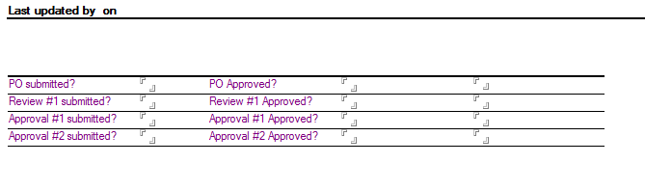
Not Required

Slide 20
Next Steps
Identify host server – immediate testing in x86 w RH Linux and follow-up testing with Power Systems w RH Linux.
Install software and test
Set up data dictionary – include field logic
Architecture for data back end
Proposed UML drawing
Data dictionary
Architecture for System
Systems reference architecture document
1st choice is Power w AIX – not possible so need to move down the choice list
2nd choice – running Power systems w Redhat Linux
3rd choice is x86 with RH Linux
4th choice is Bluehost SL with Bluemix

Slide 21
Focus Sections for Stop Ship portion of QIT
Break the form into sections
Header – title, Type of document, date tracking - Rey
Summary Status including Meeting minutes function - Rey
Action Tracker -Rey
Owner and team - Rey
Mfg Impact - Rey
Field Impact - Rey
PN, MTM - Ira
PA – sub divisions in PA -Ira
Grouper Function – Ira
Infrastructure – Ira
User Interface – Rey/Ira

Slide 22
Tracker Function
Needs to cover different processes
Stop/Prestop, PA, Incident, etc.
Needs to tie back to incident number
Needs to contain action, action type (Corrective action, Preventative action, Containment, CRB Follow-up etc.), responsible person, date due, status, status date, results.
Notifications to assigned responsible person + nag notes on action due, action late. Needs to include link to access action item from note. Ability to escalate manually
Review of response by SSC/CRB Chair/Incident Owner – approve or send back to action owner for additional action. Need ability to include comment by SSC/CRB Chair/Incident Owner explaining why reopened. For PA process, explicit approval (press button to approve and must be done before closing PA). For others – implicit approval – no need to click button.
For PA, owner cannot close item – only done by CRB team. For others, Owner can close but SSC/Incident owner has ability to reopen it.
Ability to upload list of actions by spreadsheet
Who can create – SSC for PS/S; Incident Owner for Incidents, PA prob owner for PA Process, CRB team for CRB Follow-up

Slide 23
Agenda Function for TECH OP, QIR, CRB
Click a button and tag the document to be part of agenda
Tags to put it in special section (brand/data silo - Mfg for QIR, etc)
Capture the data for that meeting
Allow the data to be displayed for a selected date
2 data elements for 2/1 and 2/8.

Slide 24
Grouper Function
Several items need to addressed by Grouper
Link multiple QIR/Tech Ops dates to document and ability to display chosen data
Link like incidents into a possible Stop/Prestop – join these into one document, master document controls the incident documents
Link like PS/S into a Pervasive Issue – more like tagging to link like PS/S to each other
Link tracker items to appropriate originating process/incident
Attributes tied to the originating process point
MTM A introduced at incident, MTM B introduced during PS/S

